Slide 1
Hybrid SDN-ICN Architecture Design for the Internet of Things
Huda Saadeh, Wesam Almobaideen, Khair Eddin Dabri and Maha Saadeh
Dept. of Information Security University of Petra, Amman, Jordan, Dept. of Electrical Engineering and computer sciences, Rochestar Institute of Technology, Dubai, UAE, Dept. of computer science, University of Jordan, Amman, Jordan , Dept. of Computer Engineering and Informtics, Middlesex University, Dubai, UAE
2019 Sixth International Conference on Software Defined Systems (SDS). IEEE, 2019. p. 96-101.

Slide 2
Outline
Abstract
Section 1: Introduction
Section 2: Background and related work
Section 3: Hybrid SDN-ICN propsed architecture
Section 4: SDN-ICN evaluation
Section 5: Conclusion and future work

Slide 3
Abstract
Internet of Things (IoT) impacts the current network with many challenges.
Monitoring and controlling network efficiently can rise the performance.
This paper proposes a new privacy aware-IoT architecture that combines the benefits of Information Centric Network (ICN) and Software Defined Network (SDN) paradigms.
This architecture controlls functionalities are distributed over multiple planes: operational plane, tactical plane and strategic plane.
Notes:
裝置的變化、異質性、當前的科技
網路的佈署將會被討論，而SDN的強化會取決於在網路內被測量的快取

Slide 4
Introdustion
IoT causes new challenges :
1. mobility
2. scalability
3. interoperability
4. privacy
Software Defined Network (SDN) targets network modifiability and maintenance .
In SDN the network is separated as control and data planes.
Interaction between control plane and data plane is usually managed by southbound protocols such as OpenFlow (OF)
Notes:
行動、可擴展性、可操作性、安全
SDN可滿足網路可變性
Data plane :data carriers、host、switch
Control plane : controller可監測、控制演算法來坐資料的轉送、安全、提供網路可視化(ex OpenDaylight、Open vSwitch)

Slide 5
Introducion
Networking paradigms can enhance the functionality of IP networking in the context of IoT are Content Delivery Network (CDN) and Information Centric Network (ICN).
CDN storage : cache users requests and services distributed in different locations to decrease traffic of communications with original servers.
ICN retrieves information, services, and actuation commands according to their names not according to their location.
Notes:
內容傳遞網路（CDN） 是指一組分佈在不同地理位置的伺服器，協同工作以提供網際網路內容的快速交付。可提供使用者特定的快取服務EX:google caches
信息中心網路ICN（Information-Centric Networking）改變當前互聯網端到端的通信機制，把內容與終端位置剝離，通過發布/訂閱範式（Publish/Subscribe Paradigm）來提供存儲和多方通信等服務。ICN打破了TCP/IP以主機為中心的連接模式，變成以信息(或內容)為中心的模式。通過ICN，數據將與物理位置相獨立，ICN網絡中的任何節點都可以作為內容生產者生成內容。
使用網絡內存來存儲用戶請求，使後續請求能夠從更接近用戶而非來源的暫存副本來提供服務，以減少在網絡上的延遲和流量負載

Slide 6
Introducion
[15]SDN controlling capabilities provides flexibility in deploying ICN architectures and enhances ICN main functions.
[14]SDN controllers and switches has been used to predict the popularity of contents to enhance ICN caching.
[2] [16] [17]ICN architecture’s designs that have separation of functionalities over multiple planes with different interaction interfaces.
This paper also proposes a hybrid SDN-ICN architecture for IoT.
Notes:
SDN控制能力提供有彈性的佈署ICN架構，提升各種功能：快取、路由轉送、名稱解析
SDN控制器和交換機可用於預測內容，並提升ICN快取功能
ICN架構的設計可以將功能分配於多個平台，並使用不同的互動介面
此篇論文將提出結合SDN和ICN的架構，並應用於物聯網的好處

Slide 7
Background
Benefits that ICN gains from SDN :
1. SDN provides approaches for ICN deployment.
2. SDN control plane supports ICN core functions
3. Decoupling controlling, and data planes in SDN
supports interoperability
Benefits that SDN gains from ICN :
1. In-network caching of ICN enhances the performance of the SDN network and decreases traffic
2. Controlling network can be implemented content-based
Notes:
解決IP legacy networks和基礎設備的問題
管理、提升、執行各種功能：快取、路由轉送、名稱解析
去耦合，SDN的資料層支持互操作性
ICN快取提升SDN的整體效能 改善交通
基於內容而非交通的控制網路

Slide 8
Background
Different methods in ICN deployment integrated with SDN , IP legacy devices and protocols according to many aspects.
Using the option fields in IPv4 and IPv6 protocols to store contents data, names, metadata, and tags.
TCP Header feserved flags are used to distinguish between ICN and non-ICN packets
Notes:
ICN的佈署可以根據不同方法並融合SDN、IP legacy devices、協定
IPv4 and IPv6 協定可以儲存內容資料、名稱、標籤等
TCP表頭標誌可以用來區分有無ICN的封包

Slide 9
Background
Data plane functionalities :
1. data delivery
2. caching
3. content naming
Controlling plane’s functionalities :
1. more network monitoring capabilities
2. enhance management of ICN functions
3. controls contents creation
4. consumption through publish/subscribe (pub/sub) approach
The control plane has been implemented in cloud.
Notes:
早期ICN架構執行在data plane執行許多功能：資料傳送、快取、內容命名等
Control plan功能：更多網路監測能力、增強管理ICN功能、控制內容創建、計算發布與訂閱方法消耗量
Control plane執行在雲端

Slide 10
Background
3 controlling units (pub/sub Model-View-Controller ) :
1. Controller units
2. View units
3. Model units
3 blocks of network items :
1. Edge network - ICN servers collect information from sensor nodes and register them into the ICN cache servers
2. Forwarding block - communicate with OF- ICN switches
3. OF-ICN controllers - manages routing, caching, security, and naming through different managing modules
Notes:
提供位置和辨識發布者和訂閱者的身份，通過添加層級來提高性能
sensor收集信息並將其註冊到 ICN 緩存服務器
OpenFlow 、ICN protocols，快取能力

Slide 11
Background
SDN-ICN deployment options :
1. clean-slate pure ICN architecture
2. static caches with special ICN software
3. edge nodes to the closest ICN capable nodes
4. the difference of using tagging
5. tagging with dynamic ICN caches placement
An overlay-ICN architecture :
two different deployment scenarios with SDN
Notes:
重頭開始的ICN架構
使用特殊ICN軟體被控制器管理的靜態快取
邊緣節點到最近的可用節點
標記節點
標記動態的快取
兩種ICN布署場景

Slide 12
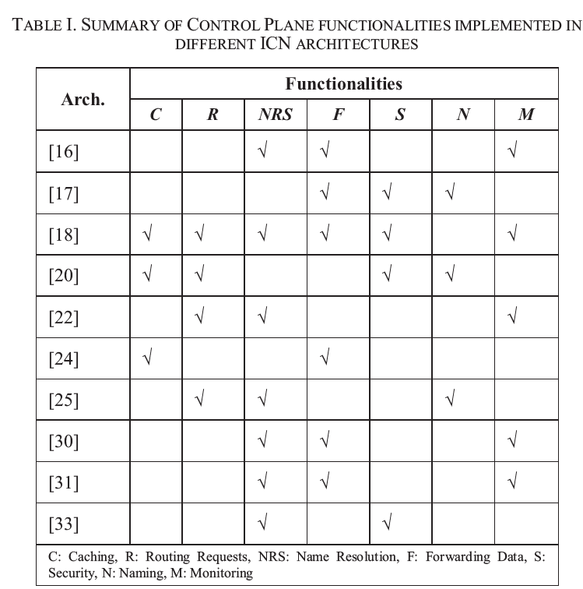
Background

Slide 13
Hybrid SDN-ICN propsed architecture
Focus points :
1. deployment approaches
2. using SDN controlling capabilities to support ICN functions
Controlling planes :
1. Operational plane
2. Tactical plane
3. Strategic plane
Controlling units :
1. Control unit
2. View unit
3. Model unit
Notes:
Operational：作為ICN data plane上的的控制器 控制local群
Tactical plane：邊緣環境 可在小群內接收中央控制的決策
Strategic plane：雲端控制環境 可做長時間的決策而影響整個網路

Slide 14
Hybrid SDN-ICN propsed architecture
Control unit
monitor network’s state, users’ behavior, privacy requirements, threats, attacks, freshness and popularity of cached contents
Operational Plane
data plane and control planes
Task : manage data delivery
Control unit and Model units :
Users authentication, Contents registration, publishing, and subscription
View units : Forwarding published data to subscribers

Slide 15
Hybrid SDN-ICN propsed architecture
Tractical plane
Divided into set of clusters.
Consists of pub/sub MVC controlling units
perform data preprocessing
smaller network areas
less extensive processing
Strategic plane
the network to perform long-term decisions
Task : require extensive computational capabilities
bigger network areas
extensive processing
Notes:
收集資訊(從control unit in operational plane)
在送資料到更高層的控制器前先進行加密
資料分析、資料可是化、AI 大量資料計算、入侵偵測

Slide 16
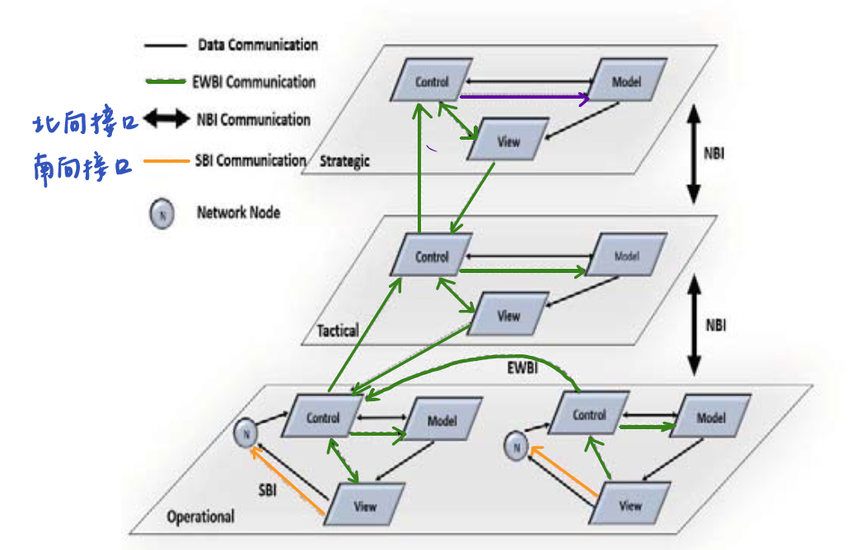
Hybrid SDN-ICN propsed architecture
SDN Communication Interfaces
Notes:
黑鍵頭__North Bound Interface (NBI) :T-C S-C T、S-V和O-MVC
橘線__South Bound Interface (SBI) : O-V和其他實體節點
綠線__East West Bound Interface (EWBI) : 不同cluster的MVC

Slide 17
Hybrid SDN-ICN propsed architecture
Cloud Computing for Hybrid SDN-ICN
Centralized computing
Storage environment with high shared capabilities
Monitor distributed systems or devices
Supports dynamic topologies
Supports mobility
Intensive processing tasks
Shortages : responses delays and security risks
Notes:
傳送和處理資料離原點很遠

Slide 18
Hybrid SDN-ICN propsed architecture
Edge computing for Hybrid SDN-ICN
secures information before being sent to cloud
Deployment Options
inter-plane communications
In the Operational plane, there are 4 options to deploy the SDN-ICN functions:
1. Providing proxies to extract ICN information
2. Adding ICN functionality for OF
3. View units prepares data packets
4. Clean-slate vision of SDN communication
Notes:
傳送和處理資料離原點很遠

Slide 19
SDN-ICN evaluation
Model unit interacts with the View unit to deliver actions commands
keeping copies inside in-network caches
decreases actions packets traffic
Notes:
儲存鄰近的訂閱者

Slide 20

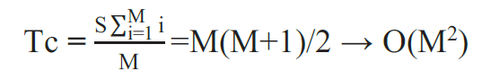


SDN-ICN evaluation
M = each switch is located at distant
S = the number of subscribed switches in the cluster
For simplification , we assume that S=M.
Traffic cost Tc to deliver actions to each switch from View without using caches
Traffic cost in which the cache is located at maximum distance M (all switches are connected to cache by one hop)
Notes:
儲存鄰近的訂閱者
Worst –case
Average

Slide 21
Conclusion and future work
This paper reviews some literature SDN-ICN architectures focusing on control plane functionalities in each.
Additional higher-level controlling functionalities are proposed in Edge computing and Cloud computing environments.
Network clusters in each plane has three controlling units (Model, View and Control) rather than having all controlling functionality in one controlling unit (SDN controller).
Notes:
每個控制平面功能
額外更高層的控制功能 運用邊緣與雲段計算環境
在不同平台的網路群集有三個單元而非SDN的中央控制單元

Slide 22
Conclusion and future work
Benefits of controlling functionalities over multiple units:
1. enhances the performance of controllers and allows for concurrent tasks processing
2. provides more abstraction levels for nodes interactions
3. enhances interoperability between different paradigms and facilitates the deployment of ICN
The paper evaluated the impact of having in-network caches on SDN actions disseminations.
Notes:
提升整體效能讓資料的處理任務更順利
精簡的接層有利於節點互動
提升互動性及ICN的布署
網路內存對 SDN 動作傳播的影響

Slide 24
SlidesCarnival icons are editable shapes.
This means that you can:
Resize them without losing quality.
Change line color, width and style.
Isn’t that nice? :)
Examples:

Slide 25
Diagrams and infographics

Slide 26
You can also use any emoji as an icon!
And of course it resizes without losing quality.
How? Follow Google instructions https://twitter.com/googledocs/status/730087240156643328
✋👆👉👍👤👦👧👨👩👪💃🏃💑❤😂😉😋😒😭👶😸🐟🍒🍔💣📌📖🔨🎃🎈🎨🏈🏰🌏🔌🔑 and many more...

